Slide 1

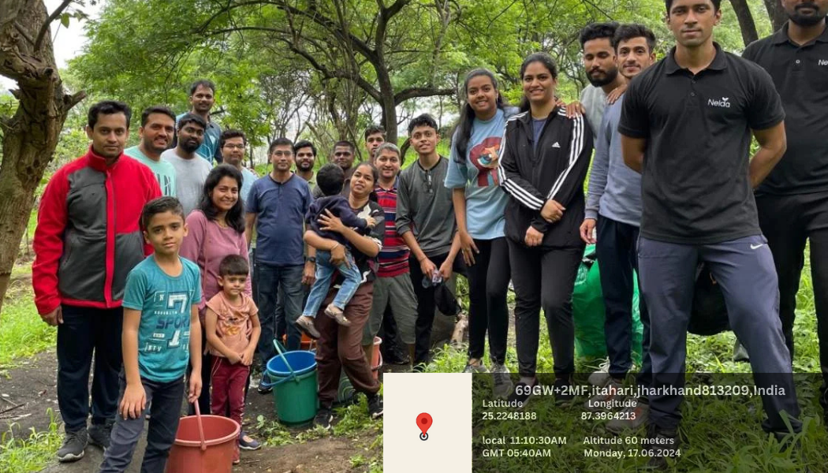

Community Development in Plantation
This presentation outlines a comprehensive community development project designed to improve the lives of residents in a plantation setting. The project will focus on addressing key challenges, engaging stakeholders, and creating a sustainable and thriving community.
by Ayush Ananad

Slide 2
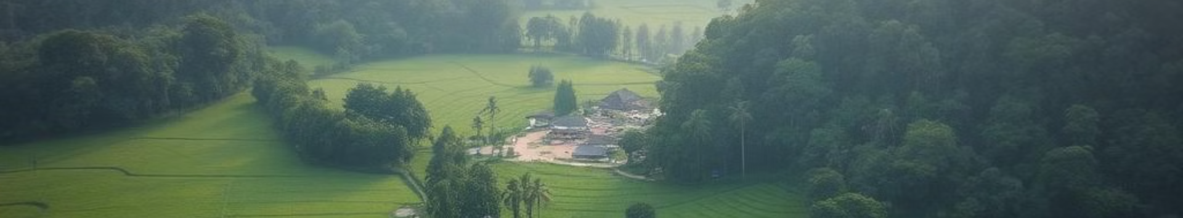
Overview of the Plantation
Geographic Location
Population Demographics
Infrastructure and Resources
The plantation is located in a rural area, surrounded by natural beauty and agricultural land. The community is close-knit, with a strong sense of place and tradition.
The community is predominantly made up of families who have lived in the area for generations. Many residents are involved in agricultural activities, while others work in nearby towns.
The plantation has limited access to essential services such as healthcare, education, and transportation. Infrastructure is generally outdated and requires improvement.

Slide 3
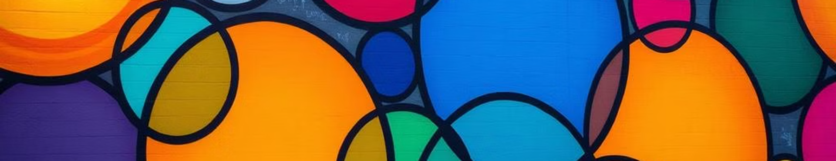
Challenges Facing the Community
1
Limited Economic Opportunities
2
Inadequate Infrastructure
3
Lack of Education and Healthcare Services
Poor roads, unreliable electricity, and insufficient access to clean water pose significant challenges to daily life.
The lack of diverse job opportunities and low income levels are contributing to poverty and economic hardship.
Limited educational opportunities and inadequate healthcare facilities hinder the community's development and well-being.

Slide 4
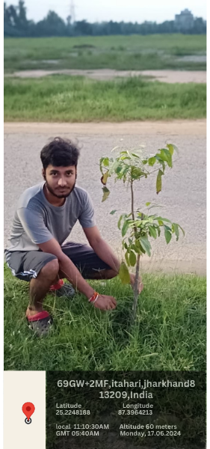
Identifying Community Needs
1
Data Collection
Gather data on demographics, economic conditions, infrastructure, and social indicators to identify key needs.
2
Needs Analysis
Analyze the collected data to identify priority areas for intervention, focusing on areas with the greatest impact.
3
Community Validation
Present the findings to community members and stakeholders for validation and feedback to ensure the project aligns with their needs.

Slide 5
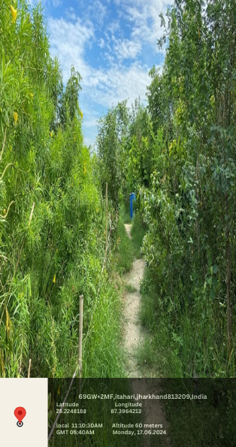



Developing a Comprehensive Plan
Project Goals and Objectives
Define clear, measurable goals and objectives that align with the identified community needs.
Project Activities and Strategies
Develop specific activities and strategies to address each objective, outlining timelines and resources required.
Monitoring and Evaluation Framework
Establish a framework to track progress, measure outcomes, and assess the effectiveness of the project.

Slide 6

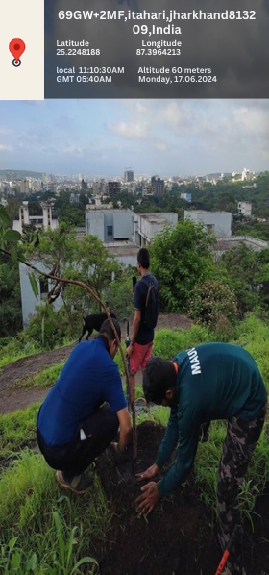
Implementing the Plan
Activity
Timeline
Resources
Develop a Vocational Training Program
Training materials, instructors, equipment
1 month
Improve Access to Healthcare
1 month
Medical supplies, healthcare professionals, transportation

Slide 7
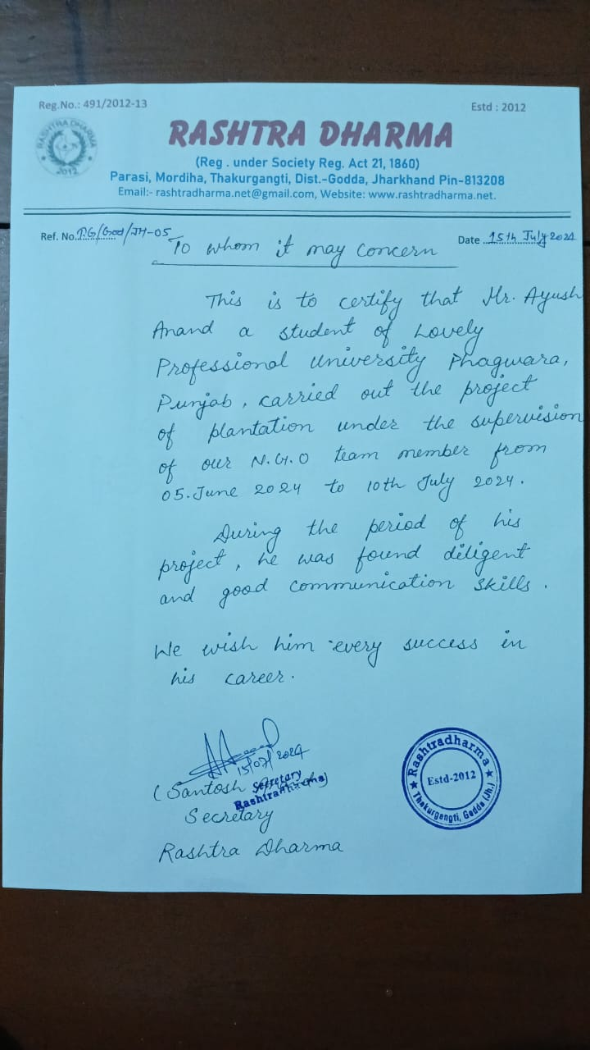
CERTIFICATE

Slide 8
CONCLUSION
In summary , our project has successfully raised awareness planted trees and achieved a positive outcome for the environment let’s continue to work together for sustainable future your involvement matters

